Slide 1
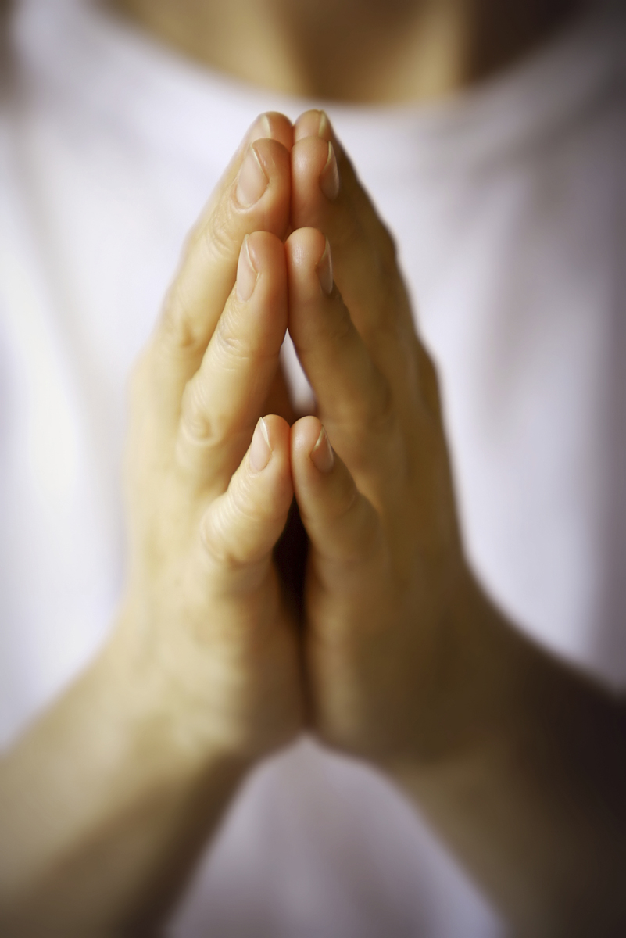
The Prayer That Works.
Luke 11:1-13 NKJV
This Photo by Unknown Author is licensed under CC BY-NC-ND

Slide 2
The Prayer That Works
Vs 1 The Disciples Request
Vs 2-4 The Way to Pray
Vs 5-8 The Way to Approach God
Vs 9-13 The Assurance from God

Slide 3
The Prayer That Works
Vs 1 The Disciples Request
‘Lord, teach us to pray, just as John taught his disciples.’
When he was baptised (3:21),
When overwhelmed by crowds (5;15,16),
When choosing the disciples (6:12)
and on many other occasions.

Slide 4
The Prayer That Works
Vs 2-4 The Way to Pray
Our Father in Heaven,
Hallowed be your name
Your kingdom come, Your will be done on earth as in heaven.
Give us each day our daily bread
And forgive us our sins, for we also forgive everyone who sins against us.
And lead us not into temptation but deliver us from the evil one.”’

Slide 5
The Prayer That Works
Vs 5-8 The Way to Approach God
The Parable of the Friend at Midnight
Travelling and Cultural Etiquette
A Poor Man’s House
Persistence cf LK18:1

Slide 6
The Prayer That Works
Vs 9-13 The Assurance from God
‘So, I say to you: ask and it will be given to you; seek and you will find; knock and the door will be opened to you.
For everyone who asks receives; the one who seeks finds; and to the one who knocks, the door will be opened.

Slide 7
The Prayer That Works
Vs 9-13 The Assurance from God
¹¹ If a son asks for bread from any father among you, will he give him a stone? Or if he asks for a fish, will he give him a serpent instead of a fish? ¹² Or if he asks for an egg, will he offer him a scorpion? ¹³ If you then, being evil, know how to give good gifts to your children, how much more will your heavenly Father give the Holy Spirit to those who ask Him!”

