Slide 1
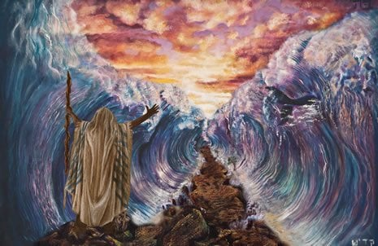

Slide 2
Crossing the Red Sea
Exodus 13:17 – 14:31

Slide 3
Gods Cunning Plan

Slide 4
Gods Cunning Plan
God’s travel plan Exodus 13:17-22
God’s battle plan Exodus 14:1-15
God’s Salvation plan Exodus 14:15-31

Slide 5
God’s Travel Plan Exodus 13:17-22
The Route - 13:17 A longer route
The Presence - 13:18 God led them around by the desert road

Slide 6
Gods Battle Plan Exodus 14:1-15
The Peoples Response
The Battle is the Lords

Slide 7
Gods Battle Plan Exodus 14:1-15
Do not be Afraid vs13
Stand Still / Firm vs 13
Move on Vs 15

Slide 8
Gods Salvation Plan Exodus 14:16-31
None of us escape the trials of life
In time of trial, we are most vulnerable
In the struggle between good and evil, victory is with God

